Slide 1
Commuter Employee Guide
Commuter Employee Guide
This brochure is designed to give you only the highlights of your Plan with OCA. For a complete description of the terms and conditions, please refer to the Summary Plan Description/Plan Information Summary which is the legal document governing this plan.

Slide 2
Commuter Benefits
A Commuter plan is an IRS approved benefit that allows you to set aside money on a TAX-FREE basis to pay for transportation and parking expenses to get to and from work!
Transit benefit allows you to use pre-tax dollars to pay for transportation expenses such as buses, rail, subway, ferry, shuttle bus, vanpool, and biking. The maximum monthly pre-tax contribution is $280.
Parking benefit allows you to use pre-tax dollars to pay for parking (parking must be near office or at a near transit station) cost to get to and from work. The maximum monthly election $280.
If enrolled in parking, employees may be reimbursed via paper check or direct deposit. This does not apply towards transit expenses. Important: Funds can only be reimbursed once the employee has contributed monies into their parking and/or transit benefit.

Slide 3
Expense Eligibility
For parking/vanpool expenses, you can only be reimbursed for expenses that were incurred getting to/from work. Transit doesn’t have to be exclusive.
What is eligible?
Buses, rail, subway, ferry, shuttle bus, vanpool, parking (parking must be near office or at a near transit station), and biking.
What is not eligible?
Carpool, telecommute, walk, taxis, tolls, fuel, and gas

Slide 4
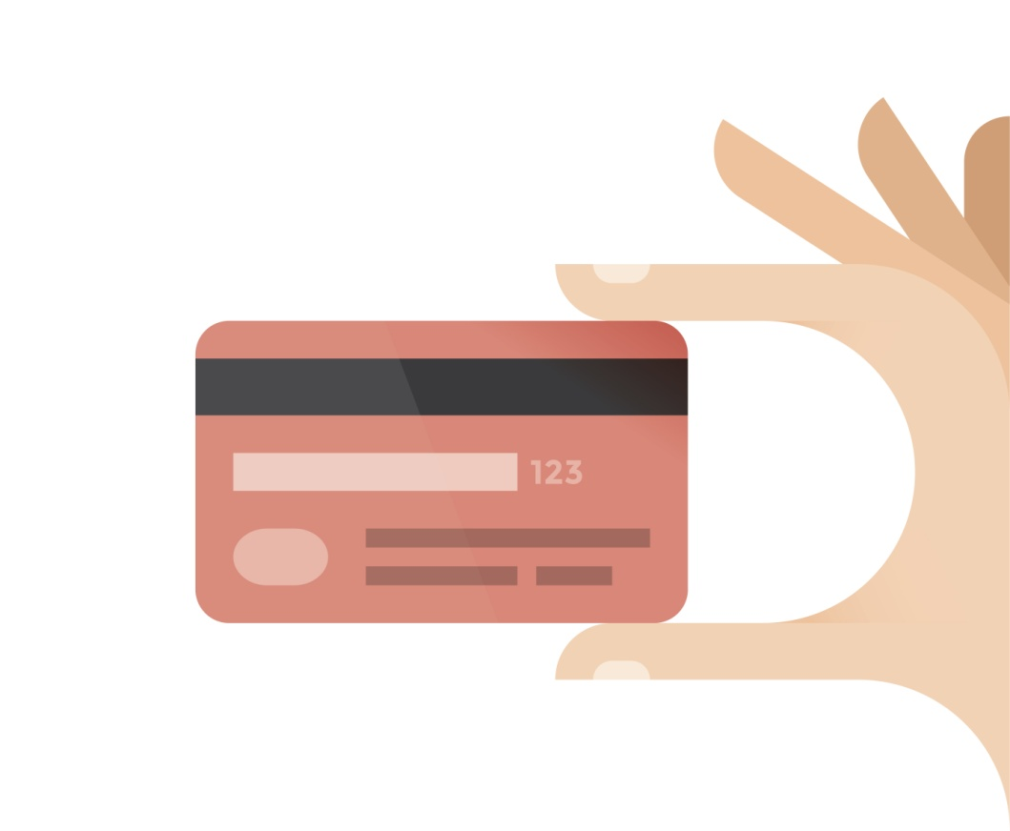
You’ll receive the OCA Debit Card
You will have a convenient OCA debit card to use for qualified parking and transit expenses for you and your eligible dependents. The credit card is linked to your Commuter programs. For Parking expenses only, you may also submit claims via our paper claim form, online claim form, or mobile app called OCA Mobile.
IMPORTANT – SAVE YOUR RECEIPTS AND
EXPLANATION OF BENEFIT STATEMENTS (EOBs)
Federal regulations require that every Parking/Transit OCA credit card transaction be substantiated in order to confirm that the transaction was for a qualified expense under the benefit plan.
Watch for emails from OCA that will indicate if supporting documentation needs to be submitted.

Slide 5
How to submit a claim to OCA?
Paper Claim Form
Mail, fax, or email the copy of your Explanation of Benefits (EOB) with a completed OCA claim form. This can be mailed to 3705 Quakerbridge Rd, Suite 216, Mercerville, NJ 08619. It can also be faxed to 609-514-2778 or emailed to claims@oca125.com
Online Claim Form
Employees can file/submit claims directly through OCA’s secure portal.
Mobile Claim Form
Employees can file/submit claims using OCA’s mobile app. It’s available in the iTunes Store and Google Play. Simply take a photo of the EOB and file your claim within seconds!

Slide 6
Create Your Online Account!
Step 1: Log into the new participant portal (myOCA) by going to www.oca125.com/myoca/ , select Participant login, then select Register. To create your new username and password you will need to use your company name and the Employee ID is your SSN. No Dashes or spaces.
Step 2: You will then be need to complete our secondary authentication process by answering 4 unique questions. For security purposes, you’ll be asked to answer two of those questions when you log in each time.
Step 3: You’ll then be asked to verify all of the information you entered. If correct, please click submit set up information to access your account.

Slide 7
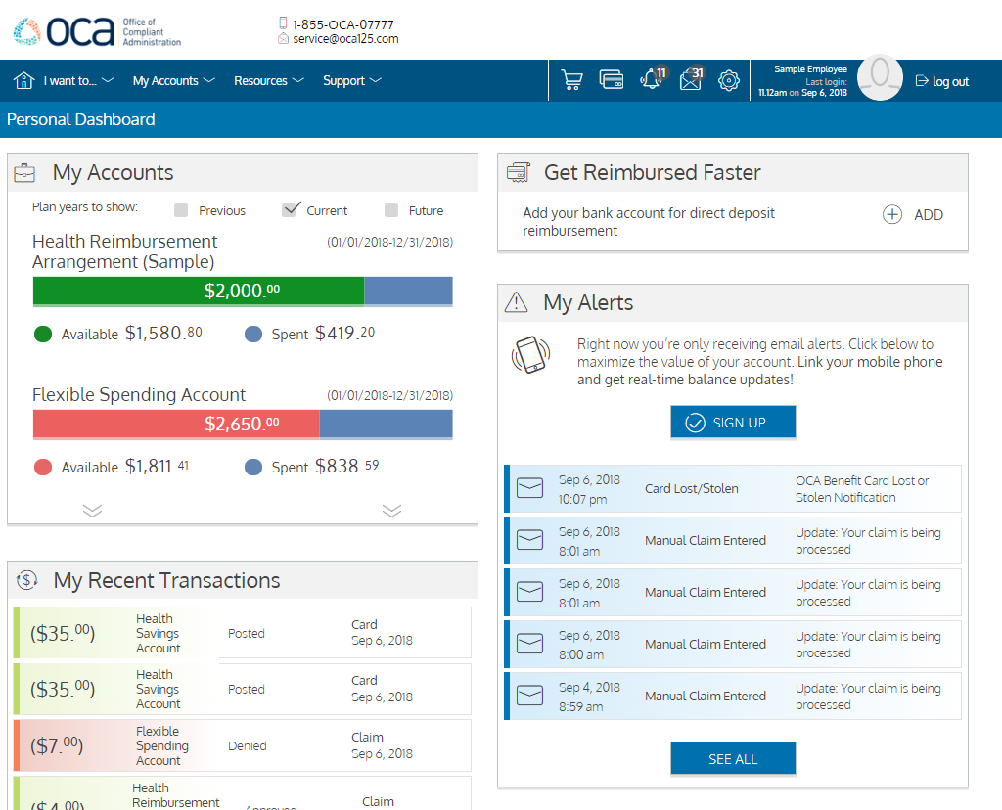
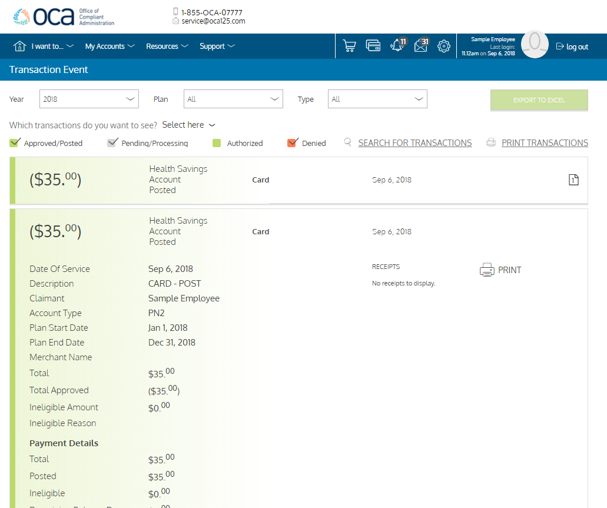
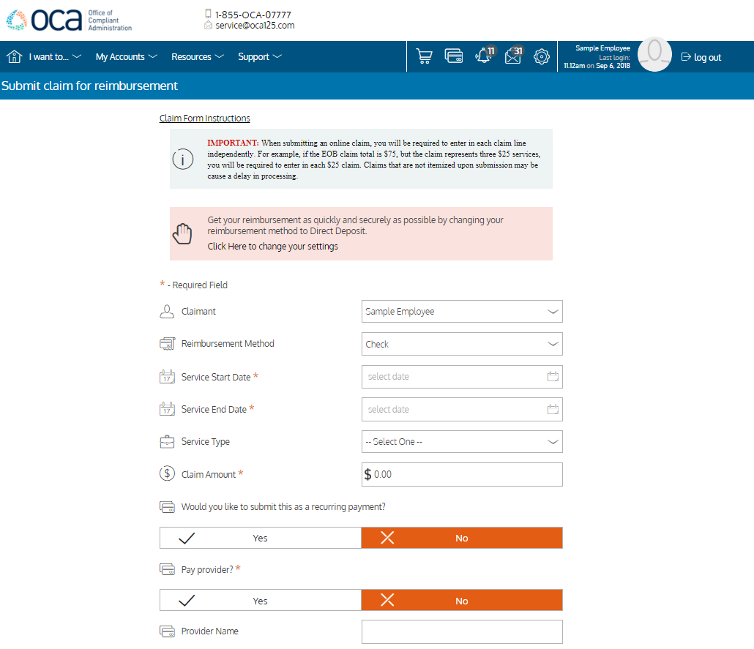
Access your benefits online!
Employees will be able to view there reimbursement history, review debit card activity, submit an online claims, and more!

Slide 8
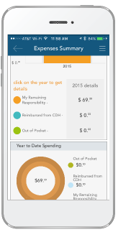
OCA Mobile
Download “OCA Mobile” in the google play or Apple Store!
OCA Mobile allows you to do the following:
Ask Emma, the CDH industry’s first voice-activated intelligent assistant, that provides answers to questions about benefit accounts
View account balances and transaction history
Submit claims & upload supporting receipt documentation via camera phone
Display receipt notification, manual claim, and reimbursement letters as pop-up messages prompting consumers to take immediate required actions
Receive & view real time alerts and important account-related communications
Perform administrative updates to profile information
Manage communication and reimbursement settings
Secure, innovative access that includes the ability to leverage smart phone touch ID technology to easily and securely access the app without typing login credentials

Slide 9
Notes

Slide 10
Questions?
We should be contacted whenever questions arise regarding processing of claims, how to submit claims, how your benefit plan works or relate to your existing insurance plans, debit cards, web access portal, ClaimsExpress, or just general knowledge/guidance questions.
OCAs Contact Information:
Phone Number: 609-514-0777 or Toll Free at 1-855-OCA-0777
Fax Number: 609-514-2778
Emails:
Service@oca125.com (Questions/Inquiries) – Any questions or inquirers regarding your claims history, card activity, balances, etc., please email OCA’s client service email.
claims@oca125.com (Claims Processing) – For participants choosing to email – rather than fax or use the online web portal or mobile app methods of remitting claims.

