Slide 1

Health Savings Accounts
Savings for Both Employers and Employees

Slide 2

Health Savings Accounts (HSAs)
What is an HSA?
A health savings account (HSA) offers your employees a tax-advantaged way to
pay for healthcare and encourages them to save for out-of-pocket expenses. The employee must be covered by a high-deductible health plan to be able to take advantage of an HSA.
HSA advantages:
Triple tax savings
Interest and investments
Easy access to funds with a debit card and
online account
Portable – an employee can take the account with
them if they leave the company

Slide 3

How Does an HSA Work?

Slide 4

Health Savings Account
Eligible participants
Who is eligible to participate?
An employee or individual can contribute to an
HSA as long as they are:
Covered by a qualified HDHP
Not covered by another “first-dollar coverage” health insurance
Not enrolled in Medicare
Cannot be claimed as a dependent on someone else’s tax return

Slide 5
Health Savings Account
Sample Employee Savings
 | No HSA | With HSA
Salary | $36,000 | $36,000
Contribution | — | $3,550
Taxable Income | $36,000 | $32,450
Taxes | $10,800 | $9,735
Healthcare Expenses | $3,500 | —
Spendable Income | $21,700 | $22,715
How it works for employees
Employer Disbursement
  Everyone receives $250
  Additional $750 can be earned through the completion of your annual physical
Voluntary salary reduction election
  An HSA enables an employee to be reimbursed with his or her own pre-tax dollars for eligible expenses not covered by a health plan. An employee participating in an HSA voluntarily elects to reduce his or her salary by a specified amount each year.
Triple tax advantage
  Contributions are made tax free
  Balance earns interest tax free
  Qualified distributions from the account are tax free
$1,038 in savings

Slide 6
Health Savings Account
Contribution options
Direct deposit: You may offer pre- or post-tax payroll deductions.
Funds transfer: Schedule one-time or recurring electronic transfers from a checking / savings account.
Account transfer: Existing health benefit accounts or IRAs may be eligible to rollover or transfer funds.
Checks: Some still prefer to send a check by mail.
How it works for employees
Contribution limits
The IRS sets annual limits on HSA contributions. The limit includes contributions from all sources. The 2021 annual contribution limits are:
  $3,600 for an individual
  $7,200 for a family
Catch-up contributions
Account holders who are 55 or older are allowed to make an additional $1,000 contribution each year. The full catch-up contribution can be made in the year they turn 55. Individuals may not make catch-up contributions for spouses turning 55, as only the account holder’s age is taken into consideration.

Slide 7
Health Savings Account
Sample expenses
Copays & coinsurance
Dental checkups
Vision exams
Contacts & eyeglasses
Laser eye surgery
Prescription drugs
Prescribed over-the-counter medication
Chiropractic care
Orthodontia
How it works for employees
Qualified healthcare expenses
HSAs cover an extensive list of eligible, reimbursable expenses, as defined by the IRS. Qualified medical
expenses are expenses for healthcare services for the participant and his or her spouse and dependents that
are not paid by insurance.
Medical expenses paid with HSA dollars cannot be claimed as a deduction on a tax return
Medical or other insurance premiums are not
qualified expenses
Participants receive 1099-SA reporting at the end of the year, which includes the total amount of distributions from the account

Slide 8

Health Savings Account
How it works for employees
Investment account features
Account holders must maintain a specific amount in their HSA before investing – this ‘maintain balance’ is displayed on the account holders’ investment account page
HSA money in excess of the HSA ‘maintain balance’ can be transferred by the participant into an investment account
Investment options include a standard list of
mutual funds
Similar to a 401k plan, participants can set up allocation models for future contributions
Participants can transfer money to or from their investment account at any time

Slide 9

Account Access

Slide 10
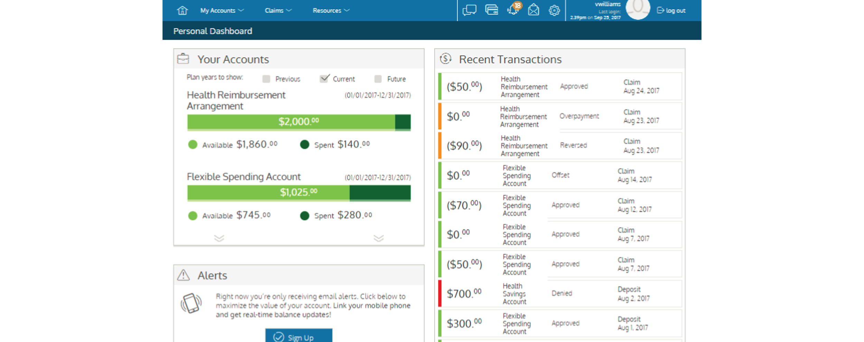
Online HSA Access
Access you myOCA online account at oca125.com/myoca
Online account access engages participants and increases HSA value
Full account details: View plan details and account history,
including prior year activity
Account management: Contribute to HSA, invest funds, view HSA
statements, bill payment, and more
Multimedia education: Access educational videos and interactive
calculators to learn more about health benefit accounts and make
|critical spend/save decisions
Manage claims: Submit new claims, upload receipts, and
check claims status
Communications: View a complete history of account
communications and manage personal preferences
Access savings: Take advantage of retail discounts, coupons,
and online shopping offers
Self-service: Take advantage of expanded account servicing options to manage debit cards, personal information, and security settings

Slide 11


Mobile HSA Access
Engage participants on the go
Access accounts: Check balances, view transaction history, fund HSA, and more
Ask questions: Emma, a voice-activated intelligent assistant, provides answers to common questions about health benefit accounts
Manage claims: Submit new claims, upload receipts, and check
claims status
Track and pay expenses: Track medical claims and other expenses,
plus pay bills electronically
Access cards: Manage card details, access PINs, and initiate card replacement for lost/stolen cards
Receive alerts: View real-time alerts, important account messages,
and edit preferred delivery methods
Update profile: Update personal information, including email and mobile phone

